Slide 1
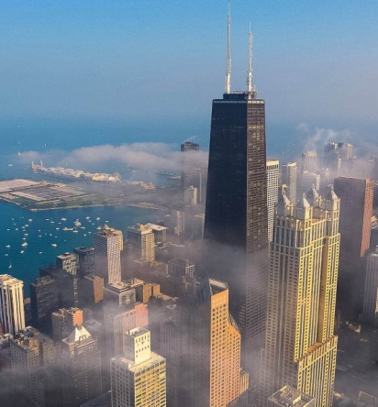
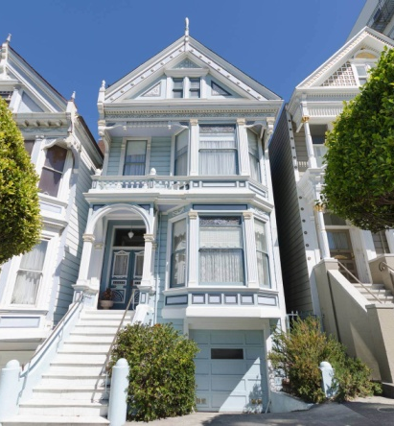


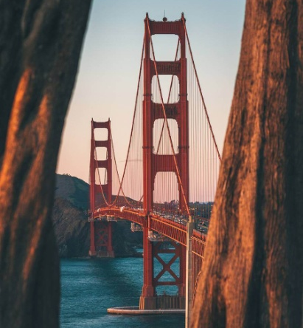

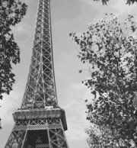
History timeline 1
THIS DAY IN HISTORY
1925
1933
1952
1964
1965
1970
1980
JANUARY
15TH
FEBRUARY
5TH
MARCH
6TH
APRIL
7TH
MAY
7TH
JUNE
17TH
JULY
18TH
Hans Luther forms German government
Crew of Dutch "7 Provinces" mutiny after pay cuts
Cuban coup d'état took place in Cuba
Hugh Martin and Timothy Gray's musical "High Spirits” opens at Alvin Theater, NYC
Bill Shoemaker wins Kentucky Derby with Lucky Debonair
British rock band Led Zeppelin begin their last European tour
Billy Joel's album tops US charts, featuring "It's Still Rock 'n' Roll to Me"

